Slide 1
19. Graph Data Structure
ECE 309
Dr. James Tuck

Slide 2
Objectives
Define what a graph data structure is.
Describe the parts of the graph data structure.
Give examples of graphs in the real world.
Represent a graph in C++ code.
Define path and determine if a path exists in a graph.
Implement code to determine if a path exists.

Slide 3
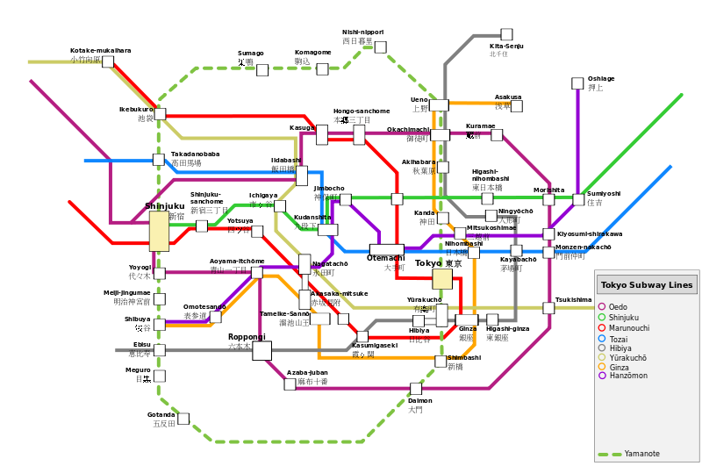
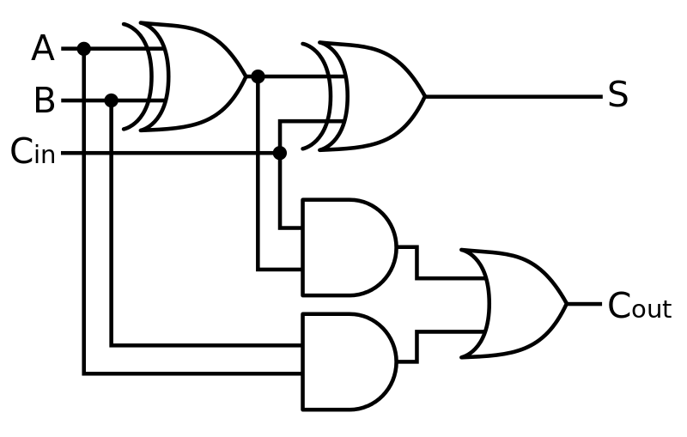
The graph data structure
A graph is a data structure for representing connections among items, and consists of vertices connected by edges.
A vertex (or node) represents an item in a graph. (i.e. train station, logic gate)
An edge represents a connection between two vertices in a graph. (i.e. train track, wire)

Slide 4
Example of a graph: social network
Vertices/nodes are people. For each person remember:
Name, Birthday, Hometown, etc
Edges imply friendship. For an edge remember:
When it was formed, special relationships (spouse, parent, child, boyfriend, etc.)
These edges don’t have a direction, friendship works the same both ways (?)
People can have many friends, so nodes in a social graph may have a large or small number of edges

Slide 5
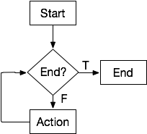
Example of a graph: flowchart
Vertices/nodes are steps in the algorithm. In each node:
String saying what to do
A shape for how it should be displayed
Edges indicate what comes next. For an edge remember:
Unconditional vs. Conditional
Boolean outcome (T or F) direction for a conditional edge
These edges have direction, we can only go one way
Vertices usually don’t have more than two edges going out.

Slide 6
Example of a graph: logic circuit
Nodes are logic gates or other circuit elements
Edges are wires
Logic gates are a special kind of vertex:
They restrict the number of incoming and outgoing wires based on function

Slide 7
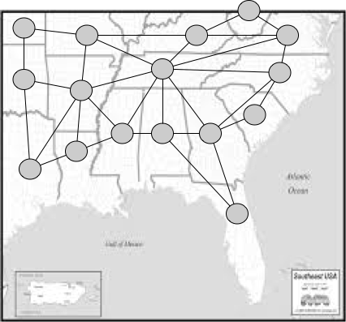
Example of a graph: map
Nodes are states
Edges indicate shared borders

Slide 8
Simplified graphs
We’ll mostly consider algorithms on simplified graphs.
Set of vertices, V, and set of edges, E
Vertices have no special meaning, identified only by a label -- possibly a name or number
An edge connects two vertices
Only one edge is allowed between two vertices

Slide 9
Graph abstract base class
// We assume we know the number of nodes up-front; not a fundamental
// requirement but it simplifies our implementation for now.
class Graph {
protected:
int numNodes; // number of nodes
public:
Graph(int num):numNodes(num){} // create a graph with num nodes
virtual void addEdge(int v1,int v2) = 0;
};

Slide 10
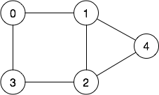
Example
Using the Graph ABS, build the following graph in code:

Slide 11
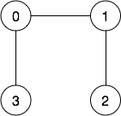
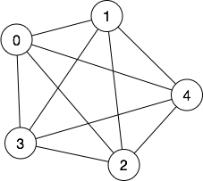
Sparse vs. dense graphs
A sparse graph is one with few edges: most nodes connect to only a few other nodes. (most common)
A dense graph is one with many edges: most nodes connect to most other nodes.

Slide 12
Adjacency
Two vertices are adjacent if connected by an edge.
Adjacency typically implies a relationship.
In a social network, adjacency implies friendship.
In a flowchart, adjacency means one vertex follows the other in execution

Slide 13
Graph representations
Two common representations
Adjacency list
Adjacency matrix

Slide 14
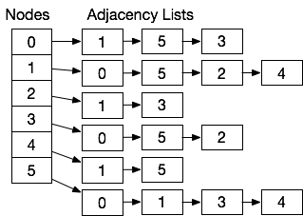
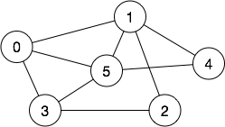
A graph via an adjacency list
Each vertex is a linked list of adjacent nodes

Slide 15
Adjacency list is a sparse representation
Adjacency list is well suited for sparse graphs.
It only needs O(V+E) in storage space.
Examples:
In a flowchart, nodes connect to only a few other nodes
In a social network, most people know a small fraction of all people on the network

Slide 16
Adjacency list implementation
class SparseGraph : public Graph {
protected:
class Node { // represents each node
public:
List edges; // adjacency list
};
Node *nodes; // array of nodes
public:
SparseGraph(int num); // create a graph with num nodes
void addEdge(int v1,int v2) override; // add edge from v1 to v2
};

Slide 17
Adjacency list implementation
// class constructor, allocate all the nodes
SparseGraph::SparseGraph(int num)
:Graph(num) /*call base class constructor*/ {
nodes = new Nodes[numNodes]; // allocate node array, each entry is a node
}
// Add an edge to the graph
void SparseGraph::addEdge(int v1,int v2) {
nodes[v1].insert(v2); // add v2 to v1’s list
// since edges are bi-directional, we add it both ways:
nodes[v2].insert(v1); // add v1 to v2’s list
}

Slide 18
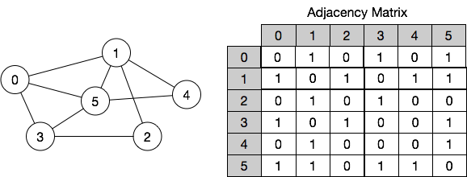
Adjacency matrix
Given N nodes, an N x N matrix is used to represent edges between nodes.
Every entry in the matrix is a boolean, 0 means no edge, 1 means edge

Slide 19
Adjacency matrices are a dense representation
Adjacency matrices can be used for sparse or dense graphs.
It needs O(V²) in storage space
It’s expensive for a graph that’s sparse
Infeasible for large V (e.g. a social network like Facebook)

Slide 20
Adjacency matrix implementation
class DenseGraph : public Graph {
protected:
bool *edges; // interpret as a 2-D array, edge[i][j] => edge[N*i + j]
public:
DenseGraph(int num); // create a graph with num nodes
void addEdge(int v1,int v2) override; // add edge from v1 to v2
};

Slide 21
Adjacency matrix implementation
DenseGraph::DenseGraph(int num)
:Graph(num) {
edges = new bool[numNodes*numNodes]; // need num*num bools
for(int i=0; i<numNodes*numNodes; i++) edges[i] = false;
}
void DenseGraph::addEdge(int v1, int v2) {
edges[v1*numNodes+v2] = true;
edges[v2*numNodes+v1] = true;
}

Slide 22
Graph implementation comparison
Operation/Metric | Adjacency List | Adjacency Matrix
Storage | O(V+E). Need a location for each node (V) that holds a pointer to the list with all of its edges (E), so V+E. | O(V²). We need a matrix for all possible edges.
Check if an edge exists | O(E). Loop through the adjacency list, worst case all edges start at the same vertex. | O(1). Directly access the location in the matrix.
Find all edges on a given node. | O(E). Loop through the adjacency list, worst case all edges start at the same vertex. | O(V) - loop through the row of the matrix; this will always be V elements.

Slide 23
Path
A path is a sequence of adjacent edges leading from a source (starting) vertex to a destination (ending) vertex.
Examples of paths:
0-1-4-5
5-4-1-0-5-3
0-1
0-1-2-3
0-4-2 // not a path! No edge from 0 to 4 or 4 to 2

Slide 24
Path Length and Distance
The path length is the number of edges in the path.
The distance between two vertices is the number of edges on the shortest path between those vertices.

Slide 25
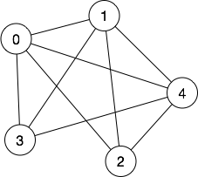
Example
Path | Length
0-3 | 1
0-1-4-2-0-1 | 5
3-0-1-4-2 | 4
Start Vertex, End Vertex | Distance
0,1 | 1
0,4 | 1
3,2 | 2

Slide 26
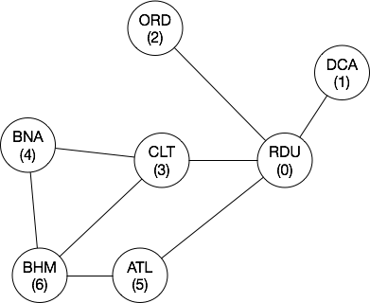
Operations on paths
Sometimes we want to know if a path exists:
Is there a direct flight from Raleigh to Birmingham?
What’s the fewest connections from Raleigh to Birmingham?
Or, in terms of a graph:
Is there a path from RDU to BHM?
We need to do a depth-first search
What is the shortest path from RDU to BHM?
We need to do a breadth-first search or shortest path

Slide 27
Calculate if a path exists
Add a member function to Graph to check if an edge exists.
Implement a function that checks if a path exists.
Store the path as an array of integers.
Build the graph showing direct flights and check for path 0-5-6.

Slide 28
Summary
The graph data structure consists of vertices and edges
Many systems can be represented as graphs (logic, software, maps, etc.)
Most graphs are sparse: only a few edges connect nodes
Two implementation strategies: adjacency list or adjacency matrix
Adjacency list is better for sparse graphs, adjacency matrices are suitable for dense graphs
A path is a sequence of adjacent edges; searching for paths of interest and finding their length are important algorithms

Slide 29
References
1. ZyBook on Data Structures, chapters 19.1 to 19.3

